Slide 1


Design Concepts
Lecture # 21

Slide 2
Modularity
A software is separately divided into name and addressable components. Sometime they are called as modules which integrate to satisfy the requirements.
Modularity is the single attribute of a software that permits a program to be managed easily.
Modular decomposability: A design method provides a systematic mechanism for decomposing the problem into sub-problems -->reduce the complexity and achieve the modularity
Modular composability: A design method enables existing design components to be assembled into a new system.
Modular understandability: A module can be understood as a standalone unit it will be easier to build and easier to change.
Modular continuity: A small changes to the system requirements result in changes to individual modules, rather than system- wide changes.
Modular protection: An aberrant condition occurs within a module and its effects are constrained within the module.

Slide 3
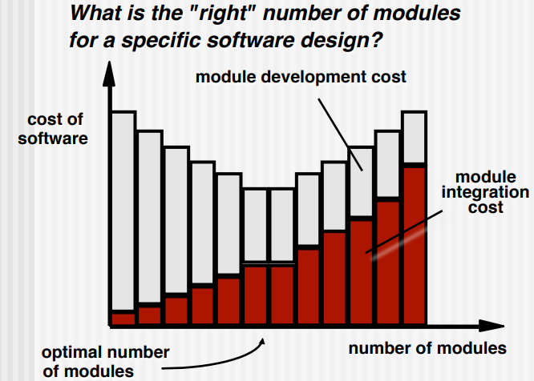

Modularity Trade-offs

Slide 4
Information Hiding
Information (data and procedure) contained within a module should be inaccessible to other modules that have no need for such information.
Hiding defines and enforces access constraints to both procedural detail within a module and any local data structure used by the module
Why Information Hiding?
Decreases the probability of adverse effects
Restricts the effects of changes in one component on others
Emphasizes communication through controlled interfaces
Discourages the use of global data
Leads to encapsulation—an attribute of high-quality design

Slide 5
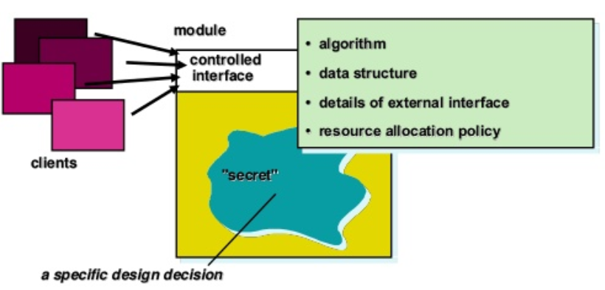

Information Hiding

Slide 6
Functional Independence
Functional independence is achieved by developing modules with "single-minded" function and an "aversion" to excessive interaction with other modules.
Independence is assessed using two qualitative criteria:
Cohesion is an indication of the relative functional strength of a module.
A cohesive module performs a single task, requiring little interaction with other components in other parts of a program. Stated simply, a cohesive module should(ideally) do just one thing.
Coupling is an indication of the relative interdependence among modules.
Coupling depends on the interface complexity between modules, the point at which entry or reference is made to a module, and what data pass across the interface.

Slide 7
Cohesion
A cohesive module performs a single task in a procedure with little interactions with others.
Goal
Achieve high cohesion for modules in a system.
Different types of cohesion:
Communication cohesion: data sharing among processing elements
Procedural cohesion: order among processing elements
Coincidentally cohesive: a set of tasks related to each other loosely
Logically cohesive: logical connection among processing elements

Slide 8
Coupling
Goal:
Strive for lowest possible coupling among modules.
Good coupling:
Reduce or avoid change impact and ripple effects.
Reduce the cost in program changes, testing, maintenance
Types of coupling:
Data coupling: parameter passing or data interaction
Control coupling: share related control logical (for a control data)
Common coupling: common data sharing
Content coupling: module A use of data or control information maintained in another module.

Slide 9
Refinement
Refinement is a top-down design approach.
It is a process of elaboration.
A program is established for refining levels of procedural details.
A hierarchy is established by decomposing a statement of function in a stepwise manner till the programming language statement are reached.
Abstraction and refinement are complementary concepts

Slide 10
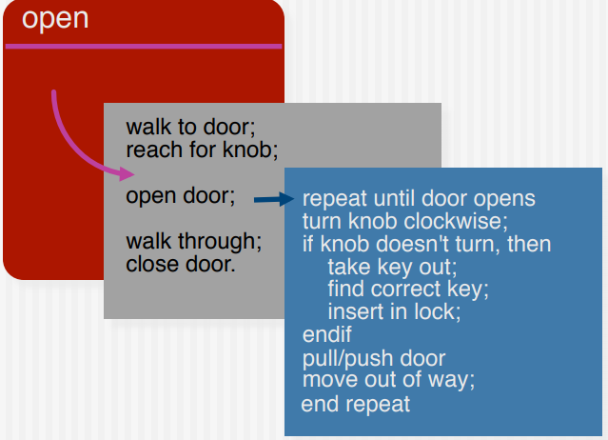

Stepwise Refinement

Slide 11
Aspect
A crosscutting concern is some characteristic of the system that applies across many different requirements.
It is important to identify aspects so that the design can properly accommodate them as refinement and modularization occur.
In an ideal context, an aspect is implemented as a separate module (component) rather than as software fragments that are “scattered” or “tangled” throughout many components.
To accomplish this, the design architecture should support a mechanism for defining an aspect—a module that enables the concern to be implemented across all other concerns that it crosscuts.

Slide 12
Refactoring
It is a reorganization technique which simplifies the design of components without changing its function or behavior.
Fowler [FOW99] defines refactoring in the following manner:
"Refactoring is the process of changing a software system in such a way that it does not alter the external behavior of the code [design] yet improves its internal structure.”
When software is refactored, the existing design is examined for:
Redundancy
Unused design elements
Inefficient or unnecessary algorithms
Poorly constructed or inappropriate data structures
or Any other design failure that can be corrected to yield better design.

